Slide 1
Lecture 1
Software and Software Engineering
Introduction to Software Engineering
This lecture is mostly based on the Chapter 1 of the book “Software Engineering: A practitioner’s approach”.
Notes:
Good morning everyone. My name is [Your Name], and I will be your instructor（讲师 /ɪnˈstrʌktər/）for this course, Introduction to Software Engineering. I received my bachelor’s degree in Software Engineering from Zhengzhou University. After that, I continued my postgraduate（研究生阶段的 /ˌpoʊstˈɡrædʒuət/）study in Australia. I completed my master’s degree at the Australian National University and later obtained（获得 /əbˈteɪn/）my PhD degree from the University of Technology Sydney. My academic background（学术背景 /ˌækəˈdemɪk ˈbækɡraʊnd/）has been consistently（一贯地 /kənˈsɪstəntli/）focused on software engineering, both in formal education and in research practice. During my years of study overseas, I experienced different academic environments, different expectations, and different approaches to teaching and research. I gradually realized that software engineering is not simply about writing code. It is a discipline（学科 /ˈdɪsəplɪn/）that combines logical thinking, systematic analysis, project management, teamwork, and long-term maintenance. In many cases, the difficulty of software development does not come from syntax or programming language, but from complexity, communication, and organization. Large systems often fail not because programmers cannot write code, but because the system design is unclear or requirements are not well defined. These experiences shaped my understanding of what software engineering truly means. I am from Henan Province, and it is meaningful for me to teach this course here. In this class, I will focus on explaining the fundamental（基础的 /ˌfʌndəˈmentl/）concepts of software and software engineering in a clear and structured（有结构的 /ˈstrʌktʃərd/）way. Today is our first lecture, and it mainly serves as an introduction. We will build a general understanding of what software is, how it differs from hardware, why software systems can become complex, and why software engineering as a formal discipline became necessary in history. We will not go deeply into technical details at this stage, but we will establish（建立 /ɪˈstæblɪʃ/）a solid foundation（基础 /faʊnˈdeɪʃn/）for the rest of the course. I would also like to clarify one important point about communication in this class. Since you are studying in China, I strongly encourage you to use Chinese as much as possible during this course. I understand that English may feel more natural for some of you, and I can certainly allow English communication when necessary. However, if you always rely on English, you may miss a valuable opportunity to improve your Chinese language ability. Language development requires practice and exposure, and the classroom provides a structured environment to strengthen your fluency. Therefore, unless there is a special situation, I recommend that you try to communicate in Chinese. At the same time, I will clearly explain technical terms and, when necessary, provide English equivalents（对应表达 /ɪˈkwɪvələnts/）to ensure that everyone can follow the content. My objective（目标 /əbˈdʒektɪv/）is not only to teach software engineering knowledge, but also to help you adapt to the academic environment here and develop independent thinking skills. By the end of this course, I hope you will not only understand the theoretical aspects of software engineering, but also gain a structured way of analyzing complex systems and solving practical problems. This course will serve as the foundation for many advanced subjects in computer science and information technology, so building a clear conceptual framework from the beginning is very important.

Slide 2
Outline
Software
Software Engineering
Notes:
On this slide, you can see two key terms: Software and Software Engineering. Although these two terms are closely related, they do not mean the same thing. Software refers to the actual programs, data, and documentation that run on a computer system. It is the product. Software engineering, on the other hand, is the systematic（系统化的 /ˌsɪstəˈmætɪk/）approach to developing and maintaining that product. It is the process and the discipline（学科 /ˈdɪsəplɪn/）behind the product. In other words, software is what we build, and software engineering is how we build it. This distinction（区别 /dɪˈstɪŋkʃən/）is very important. Many people think software engineering is simply programming, but programming is only one activity within a much larger framework. Software engineering includes requirement analysis, system design, testing, deployment, maintenance, and project management. It also involves communication between developers and clients, coordination within teams, and long-term evolution of systems. Without engineering principles, software development can easily become chaotic（混乱的 /keɪˈɒtɪk/）and inefficient. Therefore, when we study this course, we are not only learning how to write code. We are learning how to think in an organized way, how to manage complexity, and how to develop reliable systems in a structured manner. Throughout this semester, we will gradually move from understanding what software is to understanding how professional engineers design, build, test, and maintain large-scale systems. So at the beginning, it is important to keep this difference in mind: software is the result, while software engineering is the methodology（方法论 /ˌmeθəˈdɒlədʒi/）that guides the creation of that result.

Slide 3
What is software?
Software:
  (1) instructions (computer programs) that when executed provide desired features, function, and performance
  (2) data structures that enable the programs to adequately manipulate information
  (3) documentation that describes the operation and use of the programs.
Notes:
In this slide, we look more carefully at the definition of software. Software is not just a program. According to the formal definition, software consists of three main components. First, instructions, which are computer programs that, when executed, provide desired features and functions. Instructions tell the computer what to do and how to behave. Without instructions, the computer hardware cannot perform meaningful tasks. Second, software includes data structures, which are organized ways to store and manage information. A data structure determines how data is arranged, accessed, and modified. It directly affects performance, efficiency, and reliability. For example, choosing between an array, a linked list, or a tree structure can significantly influence how a system behaves. Third, software also includes documentation. Documentation explains how the system works and how users should operate it. It may include user manuals, technical spec
ifications, design documents, and maintenance guides. Documentation is often underestimated（低估 /ˌʌndərˈestɪmeɪtɪd/）, but in professional environments it is essential. Without proper documentation, future developers may not understand the system architecture（系统架构 /ˈɑːrkɪtektʃər/）, and maintenance becomes difficult. Therefore, when we use the word software, we are not only referring to code. We are referring to a complete system that includes executable programs, structured data, and supporting documents. This broader definition is important because in software engineering, we must manage all three components together. Ignoring documentation or data design can lead to long-term problems even if the program itself appears to work correctly.

Slide 4
Software Characteristics
Software is a logical rather than a physical system element. It has characteristics that are considerably different than those of hardware.
  Software is developed or engineered, it is not manufactured in the classical sense.
Notes:
On this slide, we discuss some important characteristics of software. First, software is a logical system element, not a physical one. Unlike hardware, we cannot touch or see software in a physical sense. Hardware consists of tangible components such as circuits, processors, and storage devices. Software, however, exists as logical instructions and structured data. It operates within hardware but is fundamentally different in nature. Because software is logical rather than physical, its behavior depends entirely on design and implementation. Second, software is developed or engineered, not manufactured in the classical industrial sense. When we manufacture hardware products like cars or smartphones, we produce large quantities after the design is completed. The main cost is in production. In contrast, for software, the major cost lies in development. Once a software system is created, copying it is almost cost-free. The duplication（复制 /ˌduːplɪˈkeɪʃən/）of software does not require additional material resources. Therefore, the economics（经济模式 /ˌekəˈnɒmɪks/）of software are very different from those of traditional manufacturing industries. Another important implication（含义 /ˌɪmplɪˈkeɪʃən/）is that improving software quality depends heavily on improving the development process rather than improving factory production lines. Because software is engineered, its success depends on planning, design decisions, team coordination, and systematic methodology（方法体系 /ˌmeθəˈdɒlədʒi/）. If the development process is poorly managed, the final product will likely contain defects, even if individual programmers are skilled. Understanding these characteristics helps us see why software engineering emerged as a distinct discipline. Managing logical complexity is very different from managing physical production.

Slide 5
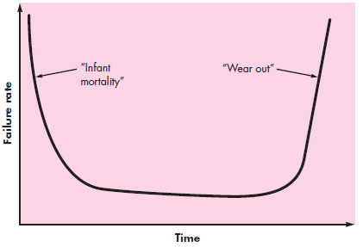
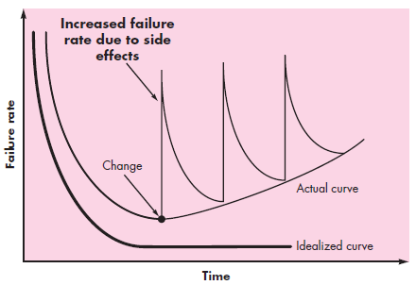
Software Characteristics(Cont’d)
  Software does not wear out.
  Figure 1.1 Failure curve for hardware Figure 1.2 Failure curve for software
  Although the industry is moving toward component-based construction, most software continues to be custom-built.
Notes:
On this slide, we examine another important characteristic of software: software does not wear out. When we talk about hardware systems, physical components gradually degrade over time. Mechanical parts experience friction, electronic components may fail due to heat, and materials eventually deteriorate（恶化 /dɪˈtɪriəreɪt/）. As a result, hardware typically follows a failure curve in which failures increase as the product ages. However, software behaves differently. Software does not physically degrade because it has no material substance. A program that works correctly today can theoretically continue to work the same way in the future, as long as the environment remains unchanged. In this sense, software does not wear out. However, this does not mean software never fails. Software failures usually occur because of design faults, implementation errors, or changes in requirements and operating environments. When we modify software, we may introduce new defects unintentionally. Therefore, the failure curve of software is different from that of hardware. Instead of increasing simply due to aging, software failures often occur after updates, revisions, or extensions. This phenomenon shows that maintenance plays a critical role in the software life cycle. In fact, in many large systems, maintenance costs exceed initial development costs. This includes corrective maintenance, adaptive maintenance, and perfective maintenance. Corrective maintenance fixes defects, adaptive maintenance adjusts the system to new environments, and perfective maintenance improves performance or functionality. Understanding this difference between hardware and software helps explain why managing change is one of the central challenges in software engineering. Software may not wear out physically, but it can become increasingly complex and difficult to manage if changes are not handled carefully.

Slide 6
Software Categories
Taxonomy:
  Function
  Scale
Notes:
On this slide, we introduce the concept of taxonomy. The word taxonomy（分类体系 /tækˈsɒnəmi/）means a systematic way of classifying or organizing things into categories. In many scientific disciplines, taxonomy helps us understand complex objects by grouping them based on shared characteristics. In software engineering, classification is also important because software systems vary greatly in purpose, size, complexity, and structure. If we do not classify them, it becomes difficult to discuss them in a structured way. On this slide, we see two major dimensions for classifying software: function and scale. Function refers to what the software does. It focuses on the role the software plays in a system. For example, some software directly interacts with hardware, while other software provides services to users. Scale, on the other hand, refers to the size and scope of the software project. It considers factors such as the number of developers involved, the time required for development, and the amount of code produced. These two dimensions help us understand that not all software projects are similar. Developing a small personal application is very different from building a large enterprise system or a nationwide infrastructure platform. By classifying software according to function and scale, we can better analyze development strategies, management approaches, and risk factors. In the following slides, we will examine each of these dimensions in more detail. Understanding classification is useful because different categories of software require different engineering practices. What works for a small project may not work for a large system. Therefore, before we study detailed methods, it is important to understand how software can be categorized.

Slide 7
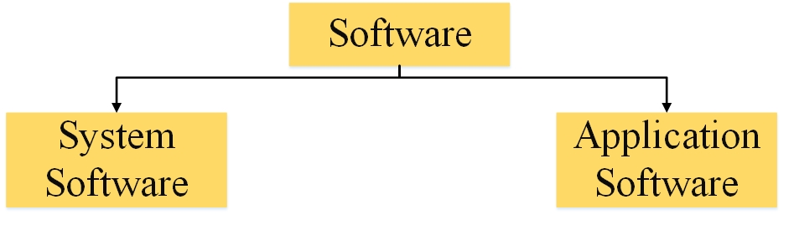
Types based on Function
Broadly divided into two types
Figure 1.3 Two types of software based on function
Notes:
On this slide, we begin to classify software based on function. Broadly speaking, software can be divided into two main categories according to what it does and the role it plays in a computing environment. These two categories are system software and application software. This functional classification helps us understand the different responsibilities that software can have within a complete computer system. System software is designed to manage hardware resources and provide basic services for other software. It operates at a foundational level and ensures that the entire computing environment runs smoothly. Application software, in contrast, is designed to solve specific user-oriented problems. It directly interacts with end users and performs tasks such as document editing, communication, data analysis, or entertainment. This distinction is important because the goals, design principles, and development processes of these two categories can be quite different. System software often emphasizes stability, efficiency, and compatibility with hardware. Application software often emphasizes usability, functionality, and user experience. In addition, the level of abstraction（抽象层次 /ˈæbstrækʃən/）is different. System software usually operates closer to hardware, while application software works at a higher level and depends on system services. By separating software into these two broad categories, we can analyze development strategies more clearly and understand how different parts of a computer system interact with one another. In the next slides, we will examine each type in greater detail and look at specific examples to make this classification more concrete.

Slide 8
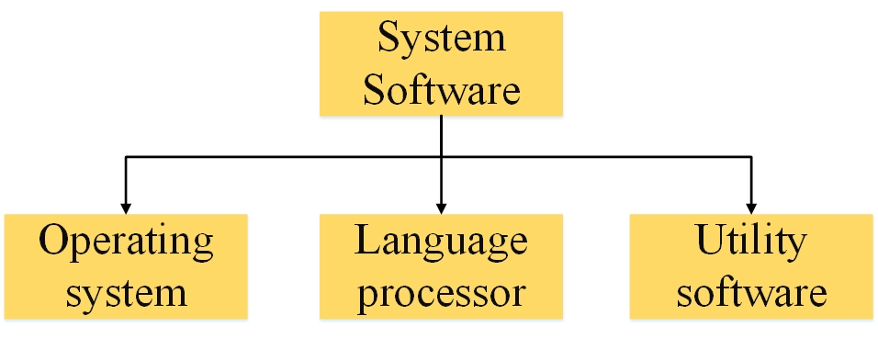
System Software
System software:
  A collection of programs written to service other programs
  Operate the computer hardware to provide basic functionality and to provide a platform for running application software.
  Aid user and hardware to function and interact with each other ( a intermediator between user and hardware).
  Figure 1.4 Three common types of system software
Notes:
On this slide, we focus specifically on system software. System software is a collection of programs designed to serve other programs rather than directly serve end users. Its primary function is to manage hardware resources and provide a stable platform for application software to run. In other words, system software acts as an intermediary（中介 /ˌɪntərˈmiːdiəri/）between hardware and application software. Without system software, application programs would need to directly control hardware devices, which would make development extremely complex and inefficient. One of the core responsibilities of system software is resource management. This includes managing CPU time, memory allocation, storage devices, and input-output operations. Another important responsibility is providing basic services, such as file systems, process control, and security mechanisms. System software ensures that multiple programs can run simultaneously without interfering with each other. It also establishes a standardized environment so that application developers do not need to worry about hardware-level details. Because system software operates close to hardware, it must be highly reliable, efficient, and stable. Errors at this level can affect the entire system. Therefore, the design and implementation of system software require careful planning and rigorous testing. Understanding system software helps us recognize that many functionalities we take for granted—such as multitasking, file storage, and network communication—are made possible by this foundational layer. In the next slide, we will look at concrete examples of system software to make this concept clearer.

Slide 9



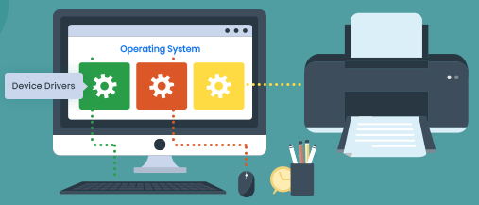
Examples of System Software
Operating system: eg. Windows, Linux, IOS, Android
  Figure 1.5 examples of operating software
Language processor:
eg. complier
Utility software:
eg. Device driver
  Figure 1.6 examples of utility software
Notes:
On this slide, we look at several concrete examples of system software. The most familiar example is the operating system. An operating system, such as Windows, Linux, iOS, or Android, manages hardware resources and provides a basic interface between users and the machine. It controls processes, memory, storage, and input-output devices. Without an operating system, users would not be able to interact with hardware in an organized way. The operating system is therefore the core component of system software. Another important type of system software is the language processor. A language processor, such as a compiler or an interpreter, translates high-level programming languages into machine-level instructions that the computer can execute. For example, when we write code in C, Java, or Python, the language processor converts that code into executable form. This translation process is essential because hardware can only understand binary instructions. The third example is utility software. Utility software includes supporting programs such as device drivers, backup tools, disk management programs, and security utilities. A device driver allows the operating system to communicate with specific hardware components, such as printers, graphics cards, or network adapters. Although utility software may seem secondary, it plays a crucial role in maintaining system stability and performance. Together, operating systems, language processors, and utilities form the foundation of the computing environment. They create the platform on which application software can run smoothly. Understanding these examples helps us see that system software is not abstract. It is something we use every day, even if we are not always aware of its presence.

Slide 10
Application Software
Stand-alone programs that solve a specific business need.
Common types:
  Word processing software: eg. Microsoft word
  Multimedia software: eg. Media player
  Communication software: eg. Wechat
Notes:
On this slide, we turn our attention to application software. Unlike system software, which operates in the background and manages hardware resources, application software is designed to directly serve users. Its primary purpose is to solve specific problems or perform particular tasks. For example, word processing software allows users to create and edit documents. Multimedia software enables users to play audio and video files. Communication software supports messaging, video calls, and online collaboration. These applications are what most people interact with on a daily basis. Application software is typically built on top of system software and depends on operating systems and other foundational services to function properly. Because it is user-oriented, application software places strong emphasis on usability, functionality, and user experience. Developers must consider interface design, accessibility, and performance from the perspective of the end user. In addition, application software often evolves rapidly in response to market demand and user feedback. New features may be added frequently, and updates are released regularly to improve performance or fix defects. Compared to system software, application software may face greater pressure from competition and customer expectations. However, despite these differences, both types of software require disciplined engineering practices to ensure quality and reliability. Understanding application software helps us recognize that software engineering principles are applied not only at the system level but also in the development of everyday tools that millions of users depend on.

Slide 11
Types based on Scale
Divide software based on some parameters such as the number of people and days for developing, lines of the program.
Types | # people | # days | # lines
Micro | 1 | 1-4 weeks | 0.5k
Small | 1 | 1-6 months | 1-2k
Medium | 2-5 | 1-2 years | 5-50k
Large | 5-20 | 2-3 years | 50-100k
Extra large | 100-1000 | 4-5 years | 1M(1M=1000k)
Extreme large | 2000-50000 | 5-10 years | 1-10M
Notes:
On this slide, we classify software based on scale. Scale refers to the size and complexity of a software project. Unlike functional classification, which focuses on what software does, scale classification focuses on how large the project is and how many resources are required to complete it. The table on this slide shows several categories, ranging from micro systems to extremely large systems. A micro project may involve one developer and take only a few weeks to complete, producing a relatively small amount of code. Small projects may take several months and involve limited team collaboration. Medium-sized systems typically require multiple developers and may take one to two years to finish. As we move toward large and extra-large systems, the number of developers increases significantly, sometimes reaching hundreds or even thousands. Development time may extend to several years, and the codebase can reach millions of lines. Extreme large systems, such as nationwide banking platforms or global operating systems, may involve thousands of engineers working collaboratively across different locations. As scale increases, complexity also increases dramatically. Communication becomes more challenging, coordination becomes more difficult, and project management becomes critical. The risk of defects and delays also rises with scale. Therefore, large-scale software development requires formal processes, clear documentation, structured management, and rigorous quality control. Understanding scale is important because the engineering methods used for small projects may not be suitable for large systems. As software grows in size, informal development approaches become insufficient. This is one of the key reasons why software engineering emphasizes process, planning, and team organization.

Slide 12
Software Crisis
Software crisis refers to problems in the process of software development and maintenance.
  How to develop software to satisfy the rapid increase in requirements?
  How to maintain the increased number of software?
Notes:
On this slide, we introduce the concept of the Software Crisis. The term Software Crisis refers to a series of serious problems that emerged in the early development of large software systems, especially during the 1960s and 1970s. At that time, computer hardware was developing rapidly, but software development methods were still immature. As systems became more complex, many projects began to fail. The word crisis（危机 /ˈkraɪsɪs/）does not mean that software development stopped, but that it encountered severe and widespread difficulties. Developers found that they could no longer rely on informal programming practices. Projects were frequently delayed, budgets were exceeded, and delivered systems often did not meet user requirements. In addition, maintaining existing systems became increasingly difficult as codebases grew larger and more complicated. One of the central questions raised during the Software Crisis was how to manage the rapid growth of software demand. As businesses, governments, and industries began to depend more heavily on computers, the need for reliable software increased dramatically. However, the available development techniques were insufficient to handle this expansion. Another critical issue was maintenance. As more software systems were deployed, organizations had to support, update, and modify them over time. Without proper design and documentation, maintenance costs escalated（升级 /ˈeskəleɪtɪd/）quickly. The Software Crisis highlighted the gap between increasing system complexity and inadequate development methodologies（方法体系 /ˌmeθəˈdɒlədʒiz/）. This historical period played a crucial role in shaping the field of software engineering. In response to these challenges, researchers and practitioners began to develop structured processes, formal design methods, and systematic quality control techniques. In other words, software engineering emerged as a solution to the Software Crisis.

Slide 13
Software Crisis (cont’d)
Manifestation:
  Projects running over-budget
  Projects running over-time
  Software was very inefficient
  Software was of low quality
  Software often did not meet requirements
  Projects were unmanageable and code difficult to maintain
  Software was never delivered
Notes:
On this slide, we examine the manifestations of the Software Crisis. The term manifestation（表现 /ˌmænɪfeˈsteɪʃən/）refers to the visible symptoms of a deeper problem. During the period of the Software Crisis, several patterns became clear across many projects. First, projects frequently ran over budget. Development costs were underestimated, and unexpected difficulties caused expenses to increase beyond initial estimates. Second, projects were often delivered late. Deadlines were missed because requirements changed, design decisions were unclear, or technical challenges were more complicated than anticipated（预期的 /ænˈtɪsɪpeɪtɪd/）. Third, the resulting software was sometimes inefficient or unreliable. Performance problems, system crashes, and incorrect outputs were common. Another major issue was that many systems did not fully meet user requirements. Developers and clients often lacked clear communication, which led to misunderstandings about what the system was supposed to accomplish. As a result, even completed systems sometimes failed to satisfy stakeholders. In addition, many projects became unmanageable as they grew in size. Codebases became difficult to maintain, documentation was incomplete, and modifications introduced new defects. In extreme cases, some projects were never completed at all. These recurring failures demonstrated that traditional programming practices were insufficient for large-scale systems. The Software Crisis made it clear that software development required more than individual programming skill. It required structured planning, formal design methods, documentation standards, and disciplined management. These manifestations served as strong evidence that a new engineering-oriented approach was necessary. This realization directly contributed to the development of software engineering as a formal discipline.

Slide 14
Software Crisis(cont’d)
Causes:
  Software scale is larger
  Software complexity is higher
  Lack of methodology
  Solution:
  Software engineering
Notes:
On this slide, we analyze the causes of the Software Crisis and discuss how the problem was addressed. There were several fundamental reasons behind the crisis. First, software systems became much larger in scale. As computers were applied in business, government, and industry, systems needed to handle more data, more users, and more complex operations. This rapid expansion increased structural complexity and made development significantly more difficult. Second, software complexity grew faster than the available development methods. Traditional programming practices were suitable for small programs, but they were inadequate for managing large and interconnected systems. Third, there was a lack of systematic methodology（方法体系 /ˌmeθəˈdɒlədʒi/）. Development often relied on individual experience rather than structured processes. Without standardized design approaches, documentation practices, or quality assurance mechanisms, projects easily became disorganized. Communication problems within teams and between developers and clients further intensified（加剧 /ɪnˈtensɪfaɪd/）the situation. As a result, errors accumulated and systems became unstable. The solution to these problems was the emergence of software engineering as a formal discipline. Software engineering introduced systematic processes, structured design techniques, formal requirement analysis, testing strategies, and project management principles. It emphasized documentation, modular design, verification, and validation. Instead of treating programming as an individual activity, software engineering treated development as an organized engineering process. The goal was to bring predictability, reliability, and control to software development. By applying engineering principles, developers could better manage complexity, reduce risk, and improve quality. Therefore, software engineering can be understood as a direct response to the challenges revealed during the Software Crisis.

Slide 15
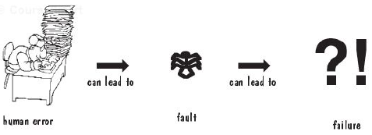
Software Failure
Fault: called error, occurs when a human makes a mistake in performing some software activities.
Failure: a departure from the system is required.
Figure 1.8 Human errors cause a failure
Notes:
On this slide, we distinguish between two important concepts in software engineering: fault and failure. These terms are related but not identical. A fault, sometimes also called an error or a defect, refers to a mistake made by a human during the development process. For example, a programmer may misunderstand a requirement, write incorrect logic, or introduce a syntax mistake. These human mistakes become faults embedded in the software system. A failure, on the other hand, refers to the observable deviation（偏离 /ˌdiːviˈeɪʃən/）of the system from its expected behavior. In other words, a failure occurs when the system does not perform according to its specified requirements. The key difference is that a fault exists inside the code or design, while a failure appears when the system is executed. Not every fault immediately leads to a visible failure. Some faults may remain dormant（潜伏的 /ˈdɔːrmənt/）for a long time and only become apparent under certain conditions. For instance, a hidden logical mistake may only trigger a failure when specific inputs are provided. This distinction is important because software quality assurance focuses on detecting faults before they cause failures. Testing, code reviews, and formal verification are methods used to identify and eliminate faults during development. If faults are not detected early, they may propagate（传播 /ˈprɒpəɡeɪt/）through the system and lead to more serious failures later. Understanding the relationship between human error, fault, and failure helps clarify why structured development processes and systematic testing are essential in software engineering. Human error leads to faults, and faults, when executed under certain conditions, lead to failures. Managing this chain effectively is a core responsibility of software engineers.

Slide 16
Software Engineering (SE)
Definition:
  Fritz Bauer: Software Engineering is the establishment and use of sound engineering principles in order to obtain economically software that is reliable and works efficiently on real machines.
  IEEE(93): (1) the application of a systematic, disciplined, quantifiable approach to the development, operation, and maintenance of software; that is, the application of engineering to software. (2) the study of the approaches as in (1).
Notes:
On this slide, we examine the formal definitions of Software Engineering. One of the earliest definitions was given by Fritz Bauer in 1968. He defined software engineering as the establishment and use of sound engineering principles to obtain economically developed software that is reliable and works efficiently on real machines. In this definition, several key words deserve attention. The phrase sound engineering principles emphasizes that software development should be based on proven, systematic methods rather than ad hoc（临时的 /ˌæd ˈhɒk/）approaches. The word economically highlights cost awareness, meaning that software should not only function correctly but also be developed within reasonable resource constraints. The terms reliable and efficient indicate that quality and performance are central goals. Later, the IEEE provided a more detailed definition. According to IEEE, software engineering is the application of a systematic, disciplined, and quantifiable（可量化的 /ˈkwɒntɪfaɪəbl/）approach to the development, operation, and maintenance of software. It also includes the study of these approaches. This definition expands the scope beyond development to include operation and maintenance, recognizing that software exists throughout a life cycle. The words systematic and disciplined emphasize structured processes and organized management. The term quantifiable suggests that measurement and evaluation are important aspects of engineering practice. In summary, both definitions share common themes: the application of engineering principles, the importance of quality, the need for cost control, and the requirement for structured processes. These definitions show that software engineering is not simply coding. It is an organized and measurable engineering activity designed to manage complexity and ensure predictable results.

Slide 17
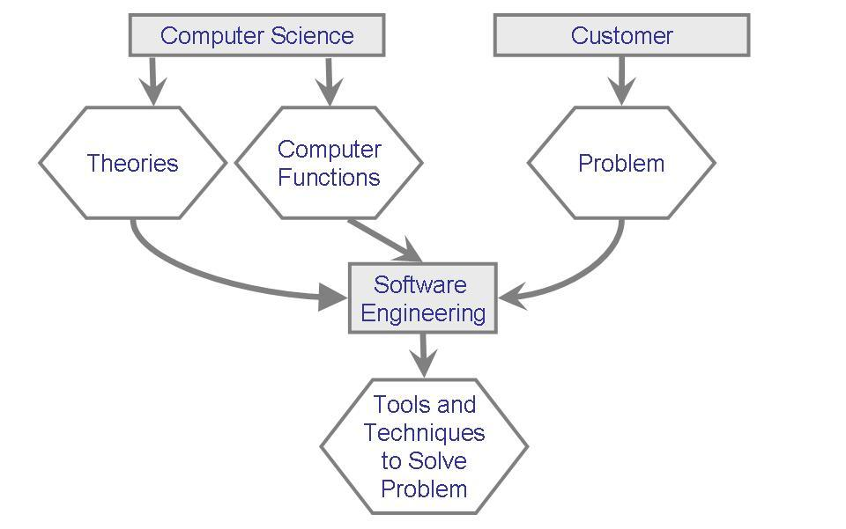
Relationship between SE and Computer Science
Software engineering is a vast sub domain which comes under computer science which is main domain.
Figure 1.9 Relationship between SE and CS
Notes:
On this slide, we examine the relationship between Software Engineering and Computer Science. Software Engineering is generally considered a subdomain of Computer Science, but the two are not identical. Computer Science focuses primarily on theory, algorithms, computation models, and the fundamental principles of information processing. It studies topics such as data structures, artificial intelligence, operating systems theory, compiler design, and computational complexity. The emphasis in Computer Science is often on mathematical foundations and theoretical correctness. Software Engineering, by contrast, focuses more on the practical aspects of building large, reliable, and maintainable systems. While it is grounded in computer science theory, its main concern is how to apply that knowledge effectively in real-world projects. Software Engineering deals with requirement analysis, system architecture design, project management, quality assurance, risk control, and maintenance strategies. It addresses questions such as how to organize teams, how to manage deadlines, and how to reduce defects in large-scale systems. In other words, Computer Science asks “how does computation work?” whereas Software Engineering asks “how do we build and manage complex software systems efficiently?” The two areas are complementary（互补的 /ˌkɒmplɪˈmentəri/）rather than competitive. A strong theoretical foundation supports good engineering practice, and engineering experience often raises new theoretical questions. Therefore, understanding this relationship helps clarify why this course emphasizes both conceptual understanding and practical methodology. Software Engineering builds upon Computer Science, but it extends beyond theory into organized development processes and real-world application.

Slide 18
A layered Technology
tools
methods
process model
a “quality” focus
Figure 1.10 Software engineering layers
Notes:
On this slide, we look at the layered structure of software engineering. The diagram illustrates that software engineering can be viewed as a technology composed of multiple layers, each serving a specific role. At the foundation of this structure is quality. Quality forms the basis upon which all other activities depend. Without a commitment to quality, processes and tools lose their purpose. Quality includes reliability, maintainability, performance, and correctness. Above quality lies the process layer. The process defines the framework for development activities. It specifies the sequence of tasks, the milestones to be achieved, and the work products to be produced. A well-defined process ensures consistency and predictability throughout the project life cycle. On top of the process layer are methods. Methods provide the technical “how-to” details for building software. They include requirement modeling, architectural design, coding practices, testing techniques, and verification procedures. Methods translate abstract goals into concrete engineering actions. Finally, at the top layer, we have tools. Tools provide automated or semi-automated support for both process and methods. Examples include version control systems, integrated development environments, testing frameworks, and project management software. These tools increase efficiency and reduce human error. The layered model demonstrates that software engineering is not a single activity but a coordinated system of principles, processes, techniques, and supporting technologies. Each layer depends on the one beneath it. Tools support methods, methods operate within processes, and processes are guided by quality objectives. Understanding this layered structure helps clarify why effective software development requires more than programming skill. It requires a structured integration of quality standards, organized workflows, technical methods, and supporting technologies.

Slide 19
Three Elements of SE
Methods:
  Provide the how-to’s technique
  Encompass a broad array of tasks, eg. requirement analysis, design, coding, testing.
  Tools:
  Provide automated or semi-automated support for the process and the methods
  A system for the support of software engineering, called computer-aided software engineering (CASE) is built through integrating many tools.
Notes:
On this slide, we examine methods and tools in more detail. In software engineering, methods refer to the technical procedures and structured techniques used to develop software systems. Methods answer the question of how a particular task should be performed. For example, requirement analysis methods help us understand user needs and translate them into formal specifications. Design methods guide us in defining system architecture, module decomposition, and interface relationships. Testing methods provide systematic strategies for verifying functionality and detecting defects. In other words, methods provide detailed guidance for each stage of development. They reduce ambiguity and increase consistency across projects. Tools, on the other hand, provide automated or semi-automated support for these methods and for the overall development process. Tools do not replace methods, but they enhance efficiency and accuracy. For example, version control tools manage code changes, integrated development environments assist in coding and debugging, and testing frameworks automate repetitive testing tasks. When multiple tools are integrated to support the entire development life cycle, the system is often referred to as CASE, which stands for Computer-Aided Software Engineering. CASE systems aim to provide comprehensive support for analysis, design, coding, and maintenance activities. The combination of methods and tools improves productivity and reduces human error. However, it is important to understand that tools alone cannot guarantee quality. Without clear methods and disciplined processes, tools may be misused or underutilized. Therefore, successful software engineering requires the coordinated application of well-defined methods supported by appropriate tools.

Slide 20
Three Elements of SE (Cont’d)
Process
  Combines the technology layers together and enables rational and timely development of computer software
  Establishes the content:
    A framework to show tasks’ order
    Which work products (models, documents, data, report, forms, etc) are produced
    Which milestones are established
    Which quality is ensured
    Which change is properly managed
Notes:
On this slide, we focus on the concept of process in software engineering. The process layer connects quality, methods, and tools into a coherent framework. A process defines the overall structure of development activities. It specifies what tasks need to be performed, in what order they should occur, and what outputs are expected at each stage. In other words, a process provides a roadmap for the entire project life cycle. A well-defined process ensures that development activities are organized rather than random. It establishes milestones, which are measurable checkpoints used to evaluate progress. It also defines work products, such as requirement documents, design models, test reports, and maintenance records. These artifacts provide traceability（可追溯性 /ˌtreɪsəˈbɪləti/）throughout the development cycle. Another important function of the process layer is change management. Software systems frequently evolve due to new requirements or environmental adjustments. A structured process ensures that changes are evaluated, documented, and implemented in a controlled manner. Without process control, modifications may introduce inconsistencies or hidden defects. In addition, process discipline improves communication among team members. When roles, responsibilities, and deliverables are clearly defined, coordination becomes more efficient. The purpose of a process is not to create unnecessary bureaucracy, but to provide rational（理性的 /ˈræʃənəl/）and timely development. A good process balances flexibility and structure. It provides guidance while allowing adaptation when necessary. Therefore, process is often considered the backbone of software engineering, because it integrates quality objectives, technical methods, and supporting tools into a unified and manageable system.

Slide 21
Software Engineering Objective
The basic objective of software engineering is to develop methods and procedures for software development that can scale up for large systems and that can be used consistently to produce high-quality software at low cost.
Notes:
On this slide, we discuss the fundamental objective of software engineering. The primary goal of software engineering is to develop high-quality software in a systematic and cost-effective manner. High quality does not only mean that the software works correctly. It also means that the system is reliable, maintainable, efficient, and adaptable to future changes. In addition, software engineering aims to ensure that development can scale to large systems. As software projects increase in size and complexity, informal approaches become insufficient. Structured processes, clear documentation, and disciplined management are required to maintain control. Another important objective is consistency. Software engineering seeks to establish methods and procedures that can be applied repeatedly across different projects. This repeatability increases predictability and reduces uncertainty. Cost control is also a central concern. Software projects often involve significant investment in time, human resources, and infrastructure. Effective engineering practices help reduce wasted effort, prevent major defects, and minimize rework. Furthermore, software engineering emphasizes risk management. Complex projects inevitably face uncertainties, such as changing requirements, technical difficulties, or resource limitations. By identifying and managing risks early, teams can prevent serious problems later. Ultimately, the objective of software engineering is to transform software development from an unpredictable activity into a controlled engineering process. It aims to balance quality, cost, and time while managing complexity in a disciplined way. This objective explains why software engineering integrates technical knowledge with organizational and managerial principles.

Slide 22
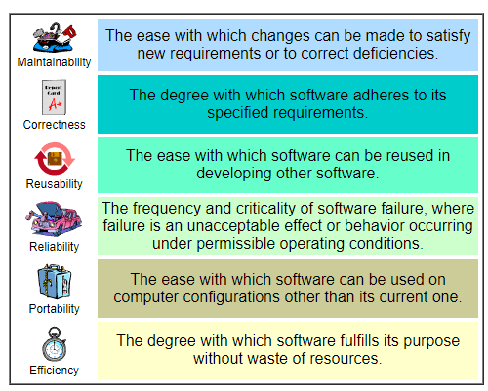
Software quality characteristics
Maintainability
Correctness
Reusability
Reliability
Portability
Efficiency
Figure 1.11 Some important software quality characteristics
Notes:
On this slide, we examine several important quality characteristics of software. In software engineering, quality is not a single concept but a combination of multiple attributes. One key characteristic is correctness. Correctness means that the software performs according to its specified requirements. If the system produces expected outputs for valid inputs, it is considered correct. Another important characteristic is reliability. Reliability refers to the probability that a system will operate without failure over a specified period of time under given conditions. A reliable system behaves consistently and does not crash unexpectedly. Maintainability is also crucial. Maintainability describes how easily a system can be modified to correct defects, improve performance, or adapt to new requirements. As software systems evolve, maintainability becomes increasingly important. Reusability refers to the extent to which components can be reused in other systems or projects. Reusable modules reduce development time and improve consistency. Portability indicates how easily software can be transferred from one environment to another, such as from one operating system to another. Efficiency concerns how well the software uses system resources, including CPU time, memory, and storage. These quality attributes are often interrelated. For example, improving performance may affect maintainability, and increasing flexibility may influence reliability. Therefore, software engineering requires balancing different quality goals. Developers must evaluate trade-offs（权衡 /ˈtreɪd ɒfs/）and prioritize according to project requirements. Understanding quality characteristics helps us define measurable objectives and assess whether a system meets professional standards. High-quality software is not defined by a single metric, but by the careful integration of multiple attributes.

Slide 23
Essence of SE Practice
Polya’s problem-solving principle describes:
  Understand the problem
  Plan the solution
  Carry out the plan
  Examine the result for accuracy
Notes:
On this slide, we introduce Polya’s problem-solving principle, which provides a structured way of approaching complex problems. Although it originated in mathematics, the principle is highly applicable to software engineering. It consists of four main steps. The first step is to understand the problem. Before attempting to design a solution, it is essential to clearly define the requirements, constraints, and objectives. Many project failures occur because teams start coding before fully understanding what needs to be built. The second step is to plan the solution. Planning involves designing the overall approach, selecting appropriate algorithms, determining system structure, and anticipating potential risks. This step transforms vague ideas into a concrete strategy. The third step is to carry out the plan. This is the implementation phase, where developers translate the design into executable code. During this stage, discipline and adherence to design decisions are critical. The fourth step is to examine the result for accuracy. This includes testing, reviewing, and validating the solution to ensure that it satisfies the original requirements. If errors are detected, the process may return to earlier steps for refinement. This iterative refinement process helps improve quality. Polya’s framework emphasizes that effective problem solving is not random but systematic. In software engineering, these four steps correspond closely to requirement analysis, system design, implementation, and testing. By following a structured approach, developers reduce uncertainty and improve reliability. Understanding this principle reinforces the idea that engineering practice is built upon disciplined thinking rather than improvisation.

Slide 24
Understand the problem
Who has a stake in the solution to the problem? That is, who are the stakeholders?
What are the unknowns? What data, functions, and features are required to properly solve the problem?
Can the problem be compartmentalized? Is it possible to represent smaller problems that may be easier to understand?
Can the problem be represented graphically? Can an analysis model be created?
Notes:
On this slide, we further expand the first step of problem solving, which is understanding the problem. In software engineering, a clear understanding of the problem is often more important than the solution itself. Before writing any code, engineers must carefully analyze the context in which the system will operate. One essential question is: who are the stakeholders? Stakeholders include users, clients, developers, managers, and any group that is affected by the system. Different stakeholders may have different expectations and priorities. Identifying them helps clarify requirements and avoid misunderstandings. Another important question concerns the unknowns. What information is missing? What data, functions, and features are required? Requirements are rarely complete at the beginning, so engineers must actively identify gaps and ambiguities. A third key consideration is whether the problem can be decomposed（分解 /ˌdiːkəmˈpoʊz/）into smaller sub-problems. Complex systems are easier to understand when broken into manageable components. Decomposition reduces cognitive load and allows parallel development. In addition, graphical representation is often helpful. Creating diagrams, models, or flowcharts makes abstract ideas more concrete and easier to communicate. Modeling also supports traceability and validation later in the process. By asking these structured questions, engineers reduce uncertainty and improve clarity. This analytical approach prevents premature implementation and supports systematic design. In professional practice, many failures occur because teams underestimate the importance of early analysis. Therefore, investing time in understanding the problem is not a delay but a strategic decision that improves overall project quality and efficiency.

Slide 25
Plan the solution
Have you seen similar problems before? Is there existing software that implements the data, functions, and features that are required?
Has a similar problem been solved? If so, are elements of the solution reusable?
Can sub-problems be defined? If so, are solutions readily apparent for the sub-problems?
Can you represent a solution in a manner that leads to effective implementation? Can a design model be created?
Notes:
On this slide, we move from understanding the problem to planning the solution. After clarifying requirements and constraints, the next step is to determine how the system should be designed. One important question is whether similar problems have been solved before. If existing solutions are available, engineers can analyze them and possibly reuse components or design patterns. Reuse reduces development time and increases reliability because previously tested solutions are often more stable. Another consideration is whether the problem can be divided into smaller sub-problems with clear interfaces. Modular design allows different parts of the system to be developed independently while maintaining overall coherence. During the planning stage, engineers also evaluate alternative approaches. Different architectures may lead to different trade-offs in performance, maintainability, and scalability. Selecting an appropriate design requires balancing these competing factors. Additionally, it is important to represent the solution in a structured form, such as design models, diagrams, or formal specifications. These representations improve communication within the team and provide a reference for implementation. Planning is not simply a theoretical exercise; it directly influences project success. Poor planning can result in inconsistent structures, duplicated functionality, or integration difficulties later in development. Effective planning requires logical reasoning, risk assessment, and systematic thinking. By carefully designing before coding, engineers reduce uncertainty and create a clear roadmap for implementation. This structured planning process ensures that development progresses in a controlled and predictable manner.

Slide 26
Carry out the plan
Does the solution conform to the plan? Is source code traceable to the design model?
Is each component part of the solution provably correct? Has the design and code been reviewed, or better, have correctness proofs been applied to algorithm?
Notes:
On this slide, we discuss the third and fourth steps of problem solving: carrying out the plan and examining the result. After completing the design, the implementation phase begins. During implementation, developers translate abstract models and architectural decisions into executable code. This stage requires discipline and attention to detail. Developers must follow coding standards, adhere to design specifications, and document their work clearly. If implementation deviates from the original design without proper justification, inconsistencies may arise. Therefore, traceability（可追溯性 /ˌtreɪsəˈbɪləti/）between design documents and source code is important. Every component of the system should correspond to a specific design element. After implementation, the next step is to examine whether the solution satisfies the requirements. This examination involves testing, code review, and validation. Testing verifies that individual components function correctly, while validation ensures that the entire system meets stakeholder expectations. Developers may use unit testing, integration testing, and system testing to detect defects at different levels. It is also important to analyze whether the implemented solution conforms to the original plan. If discrepancies（不一致 /dɪˈskrepənsiːz/）are discovered, the team may need to revisit earlier stages and refine the design. This iterative improvement process strengthens overall quality. Effective examination prevents hidden faults from propagating into later releases. In software engineering, implementation and evaluation are not isolated activities but interconnected stages within a continuous cycle of refinement. By systematically executing the plan and carefully evaluating results, engineers maintain control over complexity and ensure that the final system aligns with initial objectives.

Slide 27
Examine the result for accuracy
Is it possible to test each component part of the solution? Has a reasonable testing strategy been implemented?
Does the solution produce results that conform to the data, functions, and features that are required? Has the software been validated against all stakeholder requirements?
Notes:
On this slide, we further emphasize the importance of testing and validation in software engineering. Testing is not merely the final step before delivery; it is an integral part of the entire development process. Effective testing begins early and continues throughout the project life cycle. One key principle is that each component of the system should be testable independently. This is why modular design is important. When modules are loosely coupled and clearly defined, they can be verified separately before integration. Another essential question is whether a reasonable testing strategy has been implemented. A testing strategy defines the scope, techniques, and criteria for evaluation. For example, unit testing focuses on individual components, integration testing examines interactions between modules, and system testing evaluates the complete system in a realistic environment. Validation differs slightly from verification. Verification asks whether the system was built correctly according to specifications, while validation asks whether the correct system was built to meet stakeholder needs. Both are necessary to ensure overall quality. Additionally, testing should be systematic rather than random. Test cases must be designed carefully to cover normal scenarios, boundary conditions, and exceptional situations. In complex systems, automated testing tools help ensure consistency and repeatability. Ultimately, testing and validation provide confidence that the system satisfies functional and non-functional requirements. They reduce the risk of failure after deployment and protect the reputation of the development team. Therefore, rigorous testing is not optional but essential in professional software engineering practice.

Slide 28
Hooker’s General Principles
The Reason It All Exists
KISS (Keep It Simple, Stupid!)
Maintain the Vision
What You Produce, Others Will Consume
Be Open to the Future
Plan Ahead for Reuse
Think!
Notes:
On this slide, we discuss several practical principles that guide software engineering practice. These principles are not strict rules but guiding philosophies that help engineers make better decisions. The first principle is often summarized as KISS, which stands for “Keep It Simple.” Simplicity is a powerful concept in engineering. Complex systems are more difficult to understand, maintain, and extend. Whenever possible, solutions should avoid unnecessary complications. Simple designs are easier to test and less prone to hidden defects. Another important principle is maintaining a clear vision. Large projects often involve multiple developers working over long periods of time. Without a shared understanding of the overall objective, the system may gradually lose coherence. Maintaining the architectural vision ensures that individual components remain aligned with long-term goals. A third principle is recognizing that what you produce will be consumed by others. Code, documentation, and design decisions will be read and modified by future developers. Writing clear, structured, and well-documented code improves maintainability and collaboration. Planning for reuse is another key idea. Designing modules with reuse in mind increases efficiency in future projects and reduces duplication of effort. Finally, perhaps the most important principle is simply to think carefully. Thoughtful analysis before implementation prevents many avoidable mistakes. Software engineering is not about writing code as quickly as possible, but about building systems that remain robust and adaptable over time. These principles remind us that technical skill alone is insufficient; disciplined thinking and long-term perspective are equally essential.

Slide 29
Summary
Software
  What is software
  Software characteristics
  Software classification
  Software Crisis
Software Engineering
  What is software engineering
  Essence of software engineering practice
  Software engineering principle
Notes:
On this slide, we briefly summarize the key points covered in today’s lecture. We began by distinguishing between software and software engineering. Software refers to programs, data structures, and documentation, while software engineering refers to the systematic approach used to develop and maintain software systems. We then examined important characteristics of software, such as the fact that it is logical rather than physical, developed rather than manufactured, and does not wear out in the same way hardware does. After that, we discussed classification. Software can be categorized based on function into system software and application software, and based on scale into micro, small, medium, large, and extremely large systems. We also introduced the concept of the Software Crisis, which highlighted the difficulties encountered in early large-scale development and led to the emergence of software engineering as a formal discipline. Next, we explored key definitions of software engineering and examined its relationship with computer science. We discussed the layered structure of software engineering, including quality, process, methods, and tools, and emphasized the importance of systematic development. In addition, we introduced Polya’s problem-solving framework and connected it to requirement analysis, planning, implementation, and validation. Finally, we reviewed core engineering principles such as simplicity, structured thinking, reuse, and disciplined practice. Overall, today’s lecture established the conceptual foundation for the rest of this course. In the following classes, we will move from general principles to more specific models, techniques, and development methodologies.

Slide 30

Thanks For Your Attention!
liujinliangcs@zzu.edu.cn
Notes:
On this final slide, I would like to mention a few important points before we finish today’s lecture. First, if you have any questions after class, or if there is anything you do not understand, please feel free to send me an email. My email address is shown on this slide. I may not reply immediately, but I will respond as soon as possible. Sometimes, after you review the lecture materials by yourself, new questions may arise. That is completely normal. Learning software engineering requires reflection and repeated thinking. So if something is unclear, do not hesitate to contact me.
Second, I would like to talk briefly about the use of large language models. I do not oppose the use of tools such as ChatGPT, Google’s Gemini, DeepSeek, or Doubao. These systems are examples of large language models, or LLMs（Large Language Models，大型语言模型 /ˌlɑːrdʒ ˈlæŋɡwɪdʒ ˈmɒdlz/）. They can be helpful when you want to understand a concept, review definitions, or see examples of code. However, these tools should assist your learning, not replace your thinking. If you rely entirely on automatic answers without analyzing them, you may miss the opportunity to develop your own problem-solving ability. In software engineering, independent thinking and logical reasoning are extremely important.
Therefore, you are allowed to use these tools, but please use them responsibly. Compare answers, verify information, and try to understand the reasoning behind the output. Treat AI as a supportive instrument, not as a substitute for learning.
That concludes today’s lecture. Thank you for your attention, and I look forward to seeing you in the next class.

